Slide 1
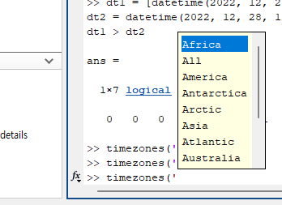
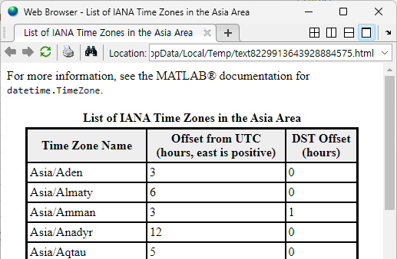

Slide 2
31
Datetime
Duration
calendarDuration
TimeTable

Slide 3





Datetime
Datetime
Dec 15th, 2002
Dec 29th, 2022
$$⋯$$
timeline
:
7319 days OR
20.0387 years
$$0.0387 ∗ 365≠14 (days)$$
Duration
:
20 years, 14 days
calendarDuration

Slide 4


Time | Temp | Height | Foo
2022-12-15 10:03:24 | 38 | 100 | 10
2022-12-15 10:58:44 | 36.5 | 120 | 15
2022-12-15 12:03:02 | 37 | 105 | 32
TT:
TT(1, :)
Time | Temp | Height | Foo
2022-12-15 10:03:24 | 38 | 100 | 10
TT{1, :}
[38, 100, 10]

Slide 5
After
re-timed
hourly

Slide 6
